Slide 1


Acharya Dhairya Bharat (AIML 01) Enrollment No.: Patel Prachi Vinodbhai (DS 29) Enrollment No.: Under the guidance of Prof. Dr. Vaidehi Mehta Submitted to
Bivariate–Multivariate Hybrid Models for Purchase Intent Prediction
CC-416 PROJECT
Project for
MSc(Integrated) AIML/DS Sem-8
By
Department of AIML/DS
School Of Emerging Science And Technology
Gujarat University
March, 2026

Slide 2
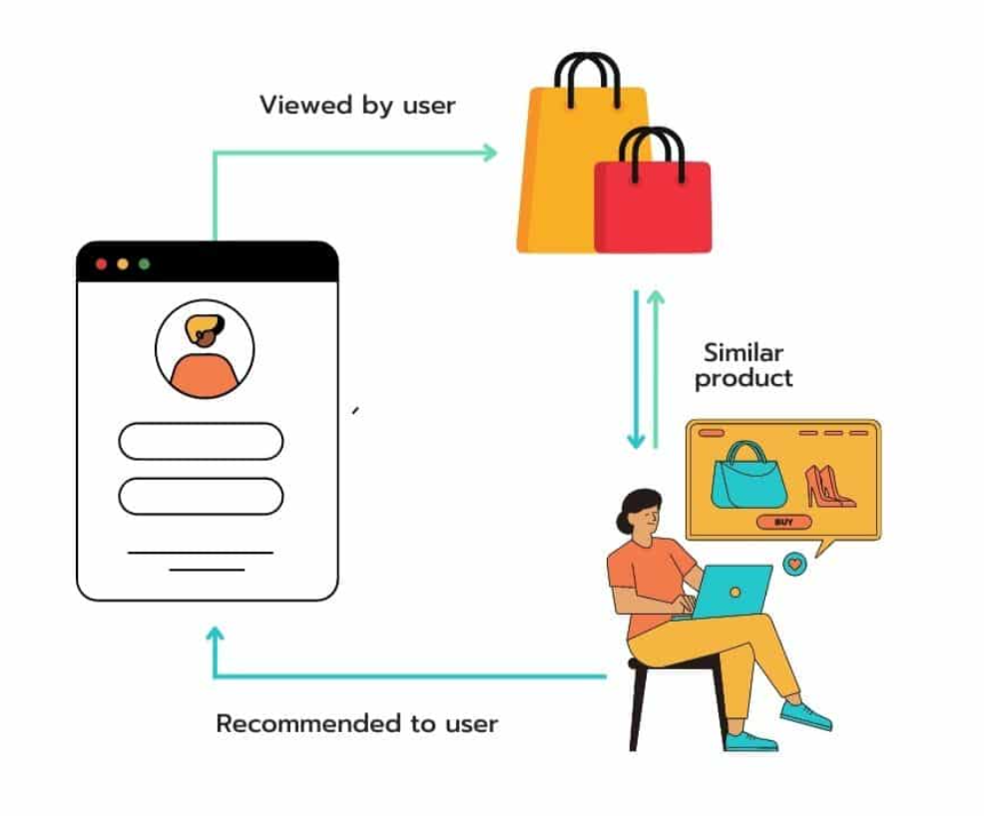
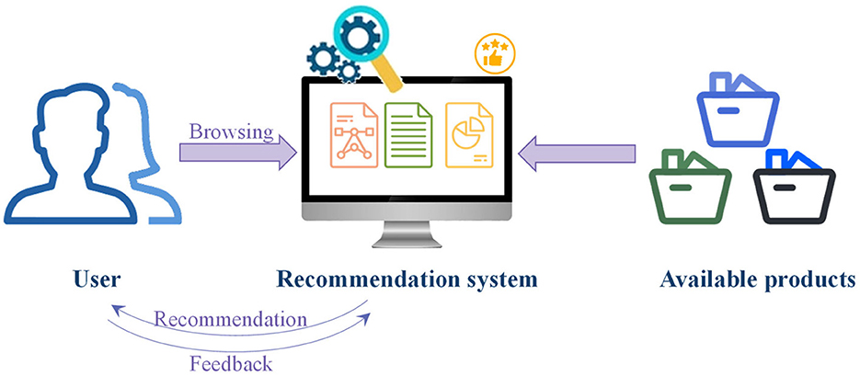
Bivariate–Multivariate Hybrid Models for Purchase Intent Prediction

Slide 3
Abstract
Purchase-intent prediction is useful for improving recommendations and marketing in e-commerce.
Understanding whether a user is likely to buy a product based on their online behaviour helps e-commerce platforms personalize their recommendations.
This project uses Bivariate–Multivariate Hybrid Models, the bivariate part captures direct relationships, such as user preferences for certain items, while the multivariate part identifies deeper trends.
Using models like Factorization Machines, DeepFM, xDeepFM, and AutoInt help capture both simple and complex relationships in clickstream data.
Our results show that hybrid models give better accuracy than basic methods and provide useful insights into what factors influence purchase decisions.

Slide 4
Keywords
Purchase Intent: likelihood of user buying a product.
Hybrid Models: combination of multiple modeling approaches.
Clickstream Data: sequential record of user online actions.
Deep Learning: neural-network based machine learning approach.
E-commerce: online buying and selling of products and services.

Slide 5
Introduction
With the rapid growth of e-commerce platforms, understanding user behavior has become more important than ever. Every time a user browses a website—clicking on products, scrolling through pages, or spending time on certain items—they leave behind valuable data. This data, known as clickstream data, can be used to understand whether a user is likely to make a purchase or not.
Predicting purchase intent is important because it helps businesses improve product recommendations, target the right customers with marketing, and increase overall sales. For example, if a system can predict that a user is likely to buy a product, it can show personalized offers or recommendations at the right time.

Slide 6
Introduction
However, predicting purchase intent is difficult. Traditional machine learning models mostly focus on simple relationships between features (like user and product), but they often fail to capture more complex patterns in user behavior. In reality, a user’s decision to purchase depends on multiple factors interacting together, such as browsing history, session duration, product categories, and more.
To address this problem, this project uses a bivariate–multivariate hybrid approach. The bivariate part focuses on direct relationships between features, while the multivariate part captures deeper and more complex patterns. By combining both approaches, the model is able to better understand user behavior and improve prediction accuracy.

Slide 7
Objective
To overcome the limitation of existing models that fail to capture both simple (pairwise) and complex (higher-order) user behavior patterns:
To study the impact of bivariate feature interactions using Factorization Machines.
To capture complex and non-linear relationships using deep learning model.
To develop hybrid models such as DeepFM, xDeepFM, and AutoInt:
To design a hybrid modeling approach that combines interaction-based models (like FM) with deep learning techniques.
To build a model that better reflects real-world user decision-making, where multiple factors interact together.

Slide 8
Objective
To enhance the system’s ability to correctly identify rare purchase events (buyers vs non-buyers):
To evaluate model performance using metrics like Accuracy, Precision, Recall, F1-score, and AUC.
To compare traditional, bivariate, multivariate, and hybrid models.
To develop a hybrid modeling approach that outperforms standalone bivariate or deep learning models.

Slide 9
Literature Review
Steffen Rendle (2010) introduced Factorization Machines (FM) for modeling sparse data with pairwise feature interactions.
→ In this project, FM is used to capture low-order (bivariate) relationships such as user–product interactions.
Huifeng Guo et al. (2017) proposed DeepFM, which combines FM with deep neural networks to jointly learn low-order and high-order feature interactions.
→ This concept forms the foundation for our hybrid modeling approach.
Jianxun Lian et al. (2018) introduced xDeepFM, which uses a Compressed Interaction Network (CIN) to explicitly model high-order feature interactions.

Slide 10
Literature Review
→ This inspires our approach to better capture complex feature combinations beyond standard deep models.
Weiping Song et al. (2019) proposed AutoInt, which uses self-attention mechanisms to automatically learn feature interactions.
→ This is used in our project to model dynamic and adaptive relationships between features.
Chawla Nitesh et al. (2002) introduced SMOTE (Synthetic Minority Over-sampling Technique) to handle class imbalance.
→ This is applied in our project to improve detection of rare purchase events.

Slide 11
Data Description
Session Activity Features:
Administrative – Number of pages related to account/admin (login, profile, etc.)
Administrative_Duration – Time spent on administrative pages.
Informational – Number of informational pages visited (about, FAQs, etc.)
Informational_Duration – Time spent on informational pages.
ProductRelated – Number of product-related pages visited.
ProductRelated_Duration – Time spent on product pages.

Slide 12
Data Description
Engagement & Behaviour Metrics:
BounceRates – Percentage of visitors who leave after viewing one page.
ExitRates – Percentage of exits from a page.
PageValues – Value of a page based on its contribution to purchase.
SpecialDay – Indicates closeness to a special day (e.g., festivals, sales).
Time-based Feature:
Month – Month of the session (e.g., Feb, Mar, Nov).

Slide 13
Data Description
User & Session Information:
OperatingSystems – User’s operating system.
Browser – Browser used (Chrome, Firefox, etc.)
Region – Geographic region of the user.
TrafficType – Source of traffic (direct, ads, referral, etc.)
VisitorType – Type of visitor (Returning / New / Other,)
Weekend – Whether the session happened on a weekend (True/False.)
Target Variable:
Revenue – Final outcome: True(1) → Purchase/False(0) → No purchase.

Slide 14
Methodology
1. Data Preprocessing:
Cleaned and prepared the dataset for modeling.
Applied label encoding to convert categorical features into numerical.
Standardized numerical features to ensure uniform scale.
Split the dataset into training and testing sets.
2. Handling Class Imbalance:
The dataset is highly imbalanced (few purchase cases).
Applied SMOTE (Synthetic Minority Over-sampling Technique) on training data.

Slide 15
Methodology
3. Model Development:
Bivariate Model-
Used Factorization Machines (FM).
Captures pairwise feature interactions (e.g., user–product relationships).
Multivariate Model-
Used Deep Neural Network (DNN).
Learns complex, non-linear, and higher-order patterns.

Slide 16
Methodology
Hybrid Models:
DeepFM → Combines FM + DNN.
xDeepFM → Explicitly models higher-order interactions.
AutoInt → Uses self-attention to learn feature relationships.
4. Model Training:
Implemented using PyTorch.
Optimizer: Adam.
Loss Function: Binary Cross-Entropy.

Slide 17
Methodology
5. Evaluation:
Models evaluated using:
Accuracy
Precision
Recall
F1-Score
AUC (ROC)
Compared performance across:
Traditional models
Bivariate models
Multivariate models
Hybrid models

Slide 18
Results And Performance Analysis
The models were evaluated on standard metrics including Accuracy, Precision, Recall, F1-score, and AUC.
Performance was compared across bivariate (FM), multivariate (DNN), and hybrid models (DeepFM, xDeepFM, AutoInt).
Factorization Machines (FM) improved prediction by capturing pairwise interactions, but showed lower recall for purchase cases
Deep Neural Network (DNN) performed better than FM by capturing non-linear behavioral patterns.
Hybrid models (DeepFM, xDeepFM, AutoInt) achieved the best overall performance, as they combine both low-order and high-order feature interactions.

Slide 19
Results And Performance Analysis
Applying SMOTE significantly improved recall and AUC, helping models better detect rare purchase events.
Model | Accuracy | Precision | Recall | F1-Score | AUC
FM | 0.88 | 0.72 | 0.54 | 0.62 | 0.81
DNN | 0.90 | 0.75 | 0.63 | 0.68 | 0.86
DeepFM | 0.92 | 0.79 | 0.70 | 0.74 | 0.89
xDeepFM | 0.93 | 0.81 | 0.73 | 0.77 | 0.91
AutoInt | 0.93 | 0.82 | 0.75 | 0.78 | 0.92

Slide 20
Conclusion
This project demonstrates that combining different modeling approaches leads to a more effective system for predicting purchase intent in e-commerce data.
By integrating both simple feature interactions and complex behavioral patterns, the hybrid models are able to better understand user decision-making.
The results show that relying on a single type of model is not sufficient for real-world data, especially when the dataset is highly imbalanced.
The proposed hybrid approach provides a more balanced and accurate prediction, making it suitable for practical applications such as recommendation systems and targeted marketing.

Slide 21
Key Findings
Hybrid models (DeepFM, xDeepFM, AutoInt) achieved the best overall performance.
Combining low-order (pairwise) and high-order (complex) interactions improves prediction accuracy.
AutoInt and xDeepFM performed particularly well due to their ability to capture deeper feature relationships.
Handling class imbalance using SMOTE significantly improved recall and AUC.
Detecting actual buyers (minority class) remains the most critical and challenging task.

Slide 22
Limitations
The dataset is highly imbalanced, which can still affect model performance despite SMOTE.
Models are trained on session-level data only, without long-term user history.
Deep and hybrid models require higher computational resources.
Results may vary across different e-commerce platforms or datasets.
Limited feature interpretability in complex models like AutoInt and deep networks.

Slide 23
Applications
Personalized Recommendation Systems: Predicting purchase intent helps platforms recommend products that users are more likely to buy, improving user experience.
Targeted Digital Marketing: Businesses can focus ads and offers on users with high purchase probability, reducing marketing cost and increasing conversion.
E-commerce Conversion Optimization: Identifying high-intent users allows platforms to take timely actions (discounts, reminders) to increase sales.
Customer Behaviour Analysis: Helps understand how users interact with the platform and what factors influence their buying decisions.

Slide 24
Applications
Real-Time Decision Systems: Models can be used in real-time to dynamically adjust content, pricing, or recommendations during a user session.
Business Intelligence & Strategy: Insights from the model can support data-driven decisions for product placement, promotions, and user engagement

Slide 25
References
Rendle, S. (2010). Factorization Machines. Proceedings of the IEEE International Conference on Data Mining (ICDM).
Guo, H., Tang, R., Ye, Y., Li, Z., & He, X. (2017). DeepFM: A Factorization-Machine based Neural Network for CTR Prediction. IJCAI.
Lian, J., Zhou, X., Zhang, F., Chen, Z., Xie, X., & Sun, G. (2018). xDeepFM: Combining Explicit and Implicit Feature Interactions for Recommender Systems. KDD.
Song, W., Shi, C., Xiao, Z., Duan, Z., Xu, Y., Zhang, M., & Tang, J. (2019). AutoInt: Automatic Feature Interaction Learning via Self-Attentive Neural Networks. CIKM.

Slide 26
References
Chawla, N. V., Bowyer, K. W., Hall, L. O., & Kegelmeyer, W. P. (2002). SMOTE: Synthetic Minority Over-sampling Technique. Journal of Artificial Intelligence Research.
He, X., & Chua, T. S. (2017). Neural Factorization Machines for Sparse Predictive Analytics. SIGIR.
Cheng, H. T., et al. (2016). Wide & Deep Learning for Recommender Systems. ACM DL.
Zhang, W., Du, T., & Wang, J. (2016). Deep Learning over Multi-field Categorical Data. ECIR.
Juan, Y., Zhuang, Y., Chin, W. S., & Lin, C. J. (2016). Field-aware Factorization Machines for CTR Prediction. RecSys.

Slide 27
References
Covington, P., Adams, J., & Sargin, E. (2016). Deep Neural Networks for YouTube Recommendations. RecSys.
Srivastava, N., et al. (2014). Dropout: A Simple Way to Prevent Neural Networks from Overfitting. JMLR.
Kingma, D. P., & Ba, J. (2015). Adam: A Method for Stochastic Optimization. ICLR.
Pedregosa, F., et al. (2011). Scikit-learn: Machine Learning in Python. JMLR.
Paszke, A., et al. (2019). PyTorch: An Imperative Style, High-Performance Deep Learning Library. NeurIPS.

Slide 28
References
Dua, D., & Graff, C. (2019). UCI Machine Learning Repository: Online Shoppers Purchasing Intention Dataset. University of California, Irvine.
Aggarwal, C. C. (2016). Recommender Systems: The Textbook. Springer.

